Slide 1


Fatih Çağlar
5/17/2024

Slide 2
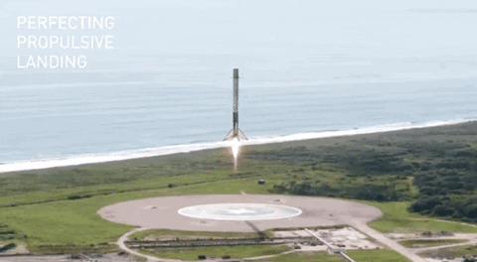

Slide 3


Outline
Executive Summary
Introduction
Methodology
Results
Conclusion
Appendix

Slide 4

Executive Summary
Our objective in this study is to conduct a predictive analysis on SpaceX Falcon-9 launches on 4 different sites in US. We collected data through SpaceX API and web scraping. After preprocessing the data and exploratory data analysis, we applied machine learning algorithms on data to be able to predict the outcomes of future launches.
Our model needs some improvements regarding the predictions about launches that lands back. It is better on negative cases at hand. The tests on out-source data didn't be conducted yet.

Slide 5
Introduction
In this project, we will try to predict if the Falcon 9 first stage will land successfully. SpaceX advertises Falcon 9 rocket launches on its website with a cost of 62 million dollars; other providers cost upward of 165 million dollars each, much of the savings is because SpaceX can reuse the first stage.
If we can determine if the first stage will land, we can determine the cost of a launch. This information can be used if an alternate company wants to bid against SpaceX for a rocket launch.

Slide 6

Section 1

Slide 7
Methodology
Data collection methodology:
SpaceX launch data has been collected via SpaceX API and scraping data from Wikipedia.
Performed data wrangling
After data wrangling, we ended up with a EDA-ready dataset consisting of 18 different features including location, equipment, outcome, payload mass and datetime information for 90 different launches.
Performed exploratory data analysis (EDA) using visualization and SQL
Performed interactive visual analytics using Folium and Plotly Dash
Performed predictive analysis using classification models
We trained four different classification model on the dataset and proceeded with Decision Tree which holding highest accuracy.

Slide 8
Data Collection
Through SpaceX RESTAPI:
SpaceX launch data has been requested and parsed using GET request.
17 different features are stored in a dataframe using customized functions to get data from json object easily.
Data got filtered to only include Falcon-9 launches.

Slide 9
Data Collection
Through Web Scraping:
Data got scraped from Falcon-9 launch Wiki page using BeautifulSoup.
HTML content got handled using loops and customized functions
There were 2 columns with missing values. One imputed by its mean and the other one leaved as it is since it was an intentional missing.

Slide 10
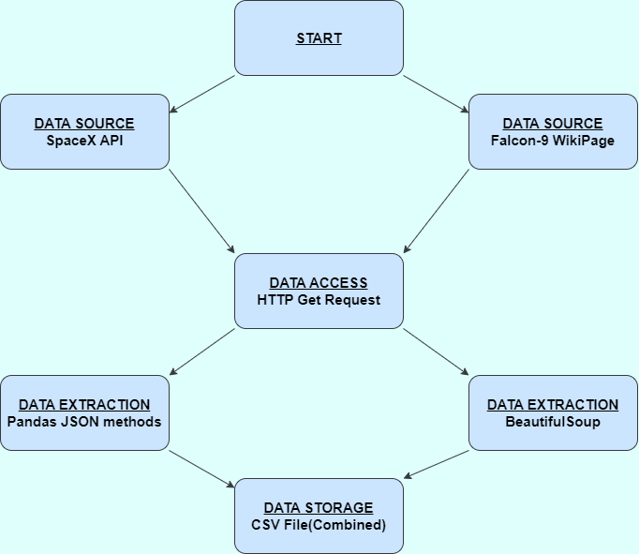
Data Collection
Code to collect data through web scraping.
Code to collect data using API.

Slide 11
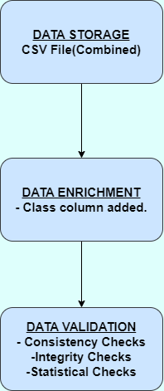
Data Wrangling
In this stage, distinct launch sites, orbits and landing outcomes and their number of appearances were explored. "Class" feature regarding landing outcome was added to dataframe for machine learning purposes. The mean of class column is approximately 0.67 ie. 67% of launches were successful.
Code

Slide 12

EDA with Data Visualization
Scatterplots (all colored by outcomes):
Payloads vs. Flight Numbers (Do payloads change over time? Are there any significant fluctuations?)
Launch sites vs. Flight Number (Which launch site hosts most flights? Any change by time?)
Launch Sites vs. Payload Mass (Which launch sites are used for small/large payloads? Any pattern?)
Orbits vs Flight Number (What is the effect of orbits to which rockets launched on outcome? What is the distribution over flight numbers?)
Payloads vs. Orbit (What are the mean payloads & outcomes for different orbits? )

Slide 13

EDA with Data Visualization
Success Rates of Different Orbits – Bar Chart (How success rate changes through orbits?)
Success Rate Through Years – Line Chart (How success rate change through years?)
Code

Slide 14

EDA with SQL
Queries:
Total payload mass carried by boosters
Average payload mass carried by specific boosters
The date when the first succesful landing outcome in ground pad was achieved
Boosters which have success in drone ship with specific payload range
Total number of successful and failure mission outcomes
Some other observations for certain time periods
Code

Slide 15

Build an Interactive Map with Folium
At this stage, we created a folium map centered at NASA Johnson Space Center and added circles for each of tree launch sites with a marker with their names. We showed launches within these circles using colored icons to denote outcomes.
We calculated the distance to nearest coastline using haversine formula and added lines between launch sites and coastlines.
Code

Slide 16
Build a Dashboard with Plotly Dash
SpaceX Launch Records Dashboard consists of a dropdown menu to select a launch site (or all), a pie chart that shows outcome rates for launch sites and a scatter plot that shows relation between outcomes and payloads. There is also a slider to select a range for payload.
This dashboard gives stakeholders the opportunity of exploring data more deeply themselves and provides a space without a crowd of plots thanks to its interactivity.
Code

Slide 17

Predictive Analysis (Classification)
To find the best model for Falcon-9 first stage landing prediction, we selected 4 different models, and passed the parameter grid for these models to GridSearchCV and fitted on our training data which is 80% of all dataset.
We evaluated the models using best parameters and best score grid search gave and using our test data. Decision tree gave the best score which is approximately 0.89.
Code

Slide 18
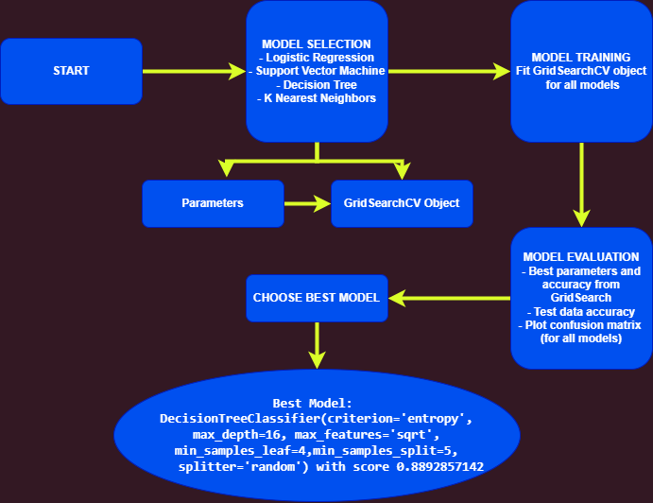

Slide 19
Results
Some results from EDA
Interactive analytics demo in screenshots
Predictive analysis results

Slide 20

INSIGHTS
Total success rate is 0.67.
There are 99 successful missions. One mission had failed and payload status of one successful mission is unclear.
CCAFS LC-40 has a success rate of 60 %, while KSC LC-39A and VAFB SLC 4E has a success rate of 77%.
Out of 11 unique orbits, 4 ones have a success rate of 100% and orbit SO has not any successful landing.
The success rate since 2013 kept increasing till 2020 except a down of 25% in 2018.
For approximately 75% of flights, payload mass is less than 10 tones.

Slide 21
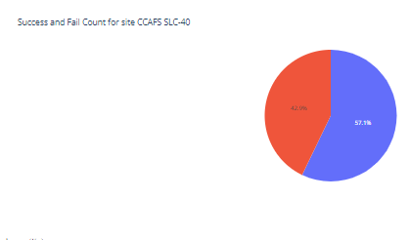
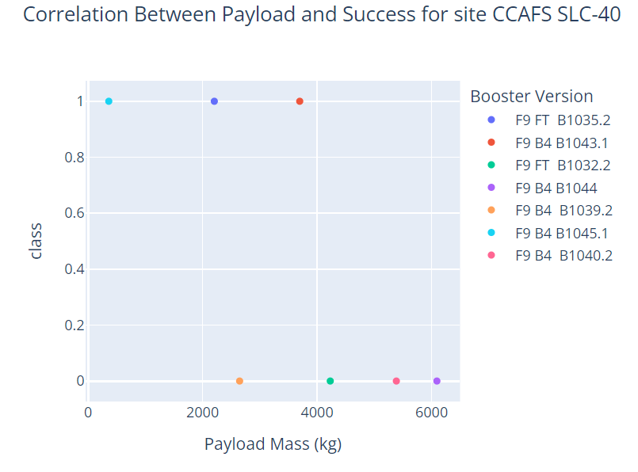
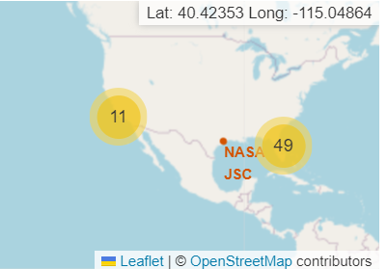
CHARTS AND MAPS
Check more at live app

Slide 22
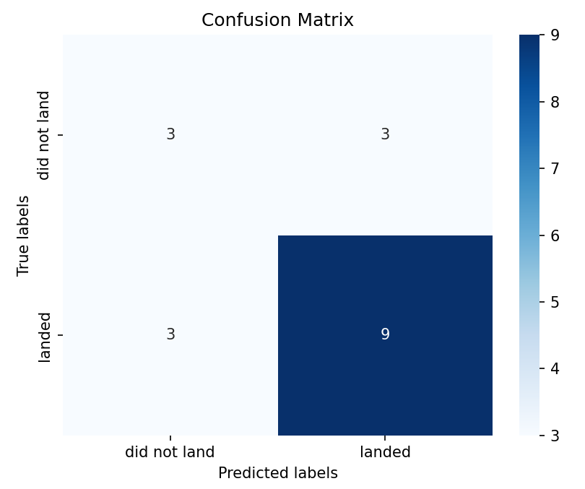
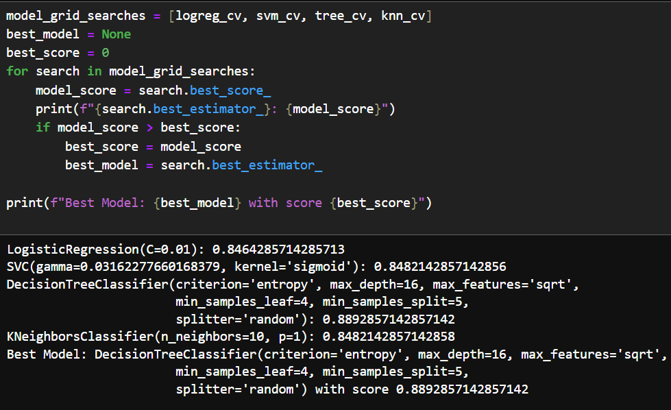
Predictive Analysis Results
Best machine learning model for the dataset is Decision Tree.
Its accuracy is 0.889.

Slide 23

Section 2

Slide 24
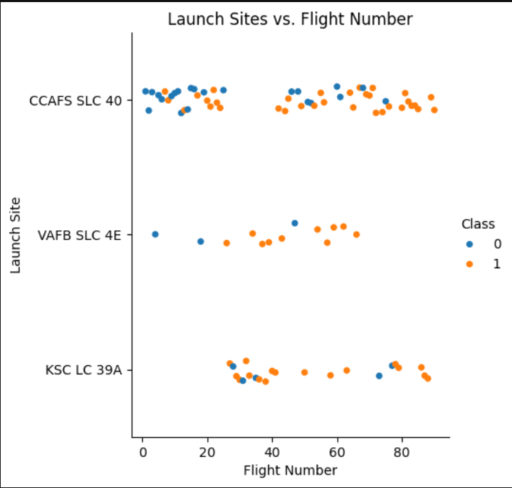
Flight Number vs. Launch Site
Sites VAFB SLC 4E and KSC LC 39A seem to have high success rates. CCAFS SLC 40 hosts large number of launches but it's success rate is not that much.

Slide 25
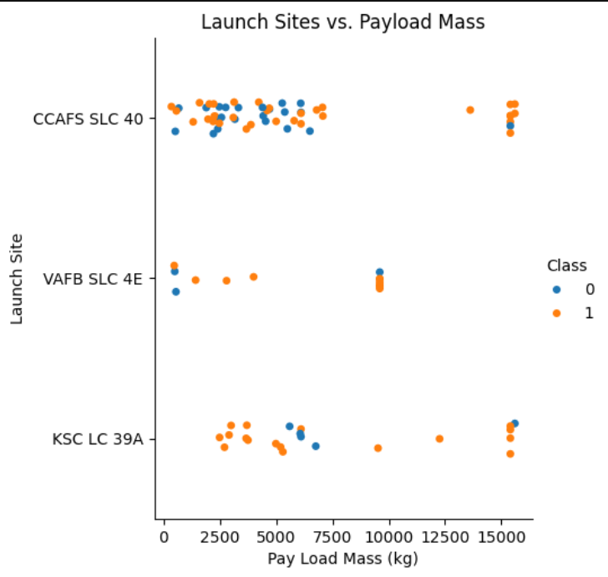
Payload vs. Launch Site
Most of launches are with payloads less than 10000 kg.
Launches with payloads greater than 10000 are from CCAFS SLC 40 & KSC LC 39A and of very high success rate.

Slide 26
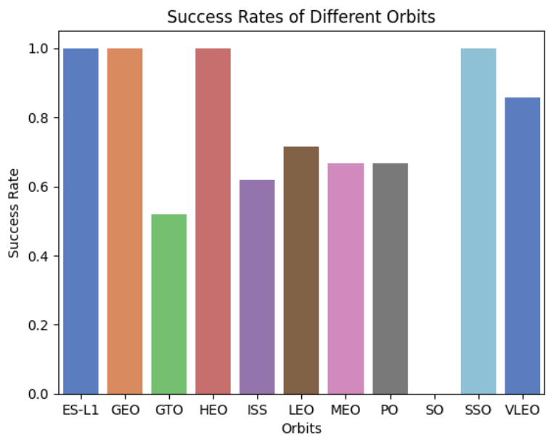
Success Rate vs. Orbit Type
There are 11 different orbits and 4 of them have full success rate. 6 orbits have success rate between 0.5 and 0.8 and launches to one orbit are all failed.

Slide 27
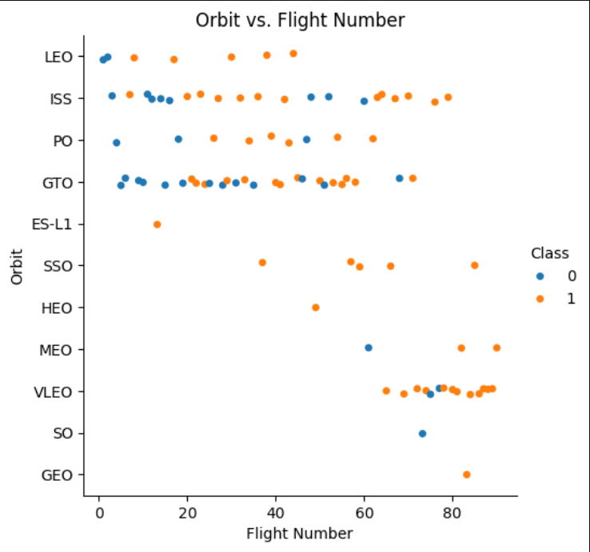
Flight Number vs. Orbit Type
First 20 launches have very low success rate and after 20th, success rate is very high. 7 of orbits are not preferred much until 60th launch.

Slide 28
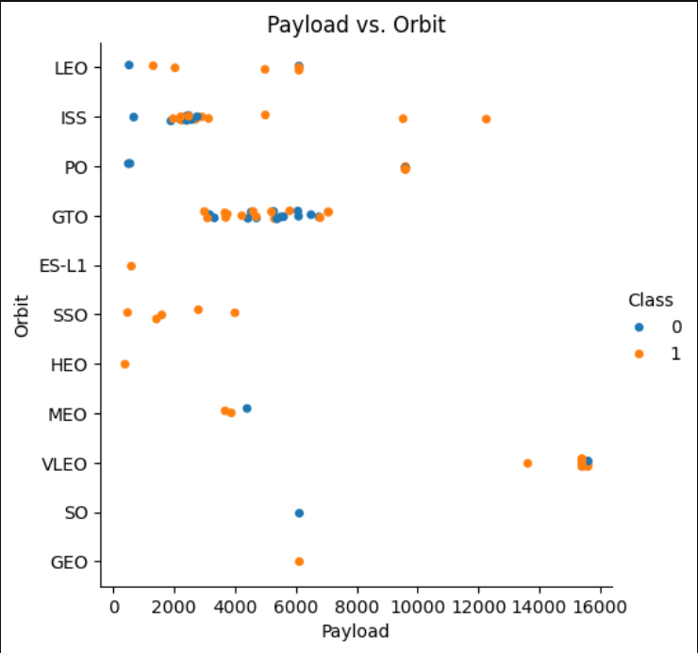
Payload vs. Orbit Type
Highest number of launches are to GTO and their payload is in range of 2000-8000.

Slide 29
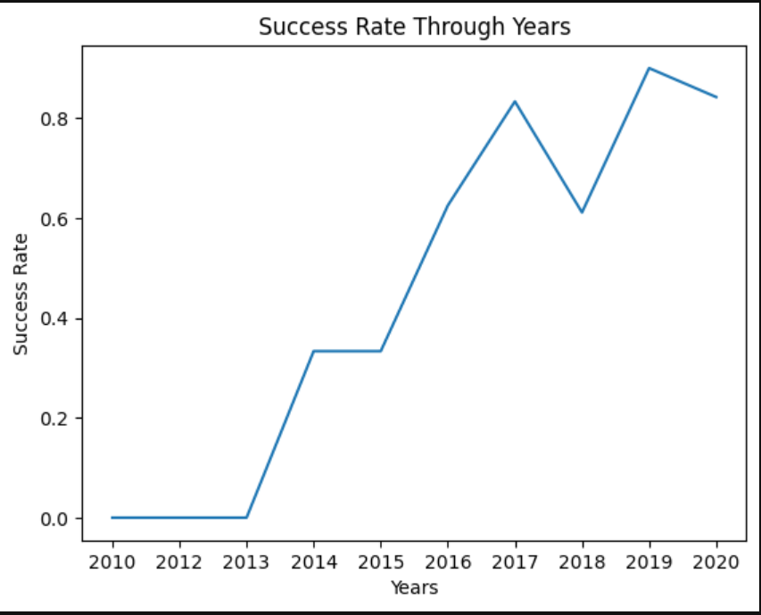
Launch Success
Yearly Trend
The success rate since 2013 kept increasing till 2020 except a down of 25% in 2018.

Slide 30
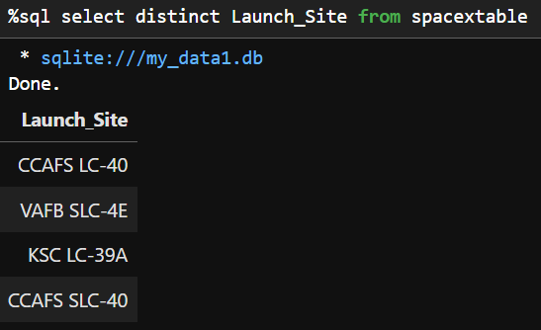
All Launch Site Names
There are 4 unique launch sites.

Slide 31
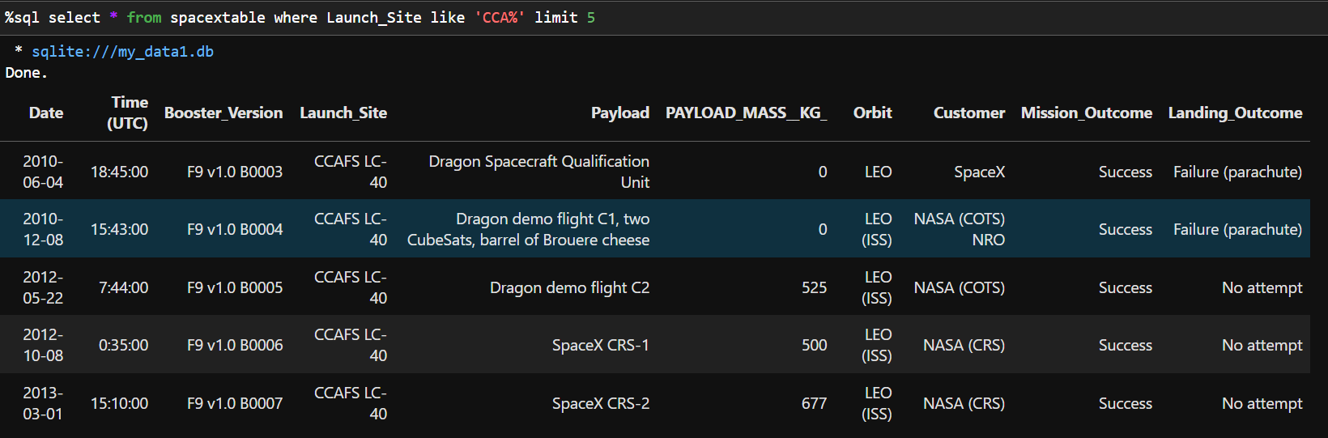
Launch Site Names Begin with 'CCA'
See the similarity between orbits and customers.

Slide 32
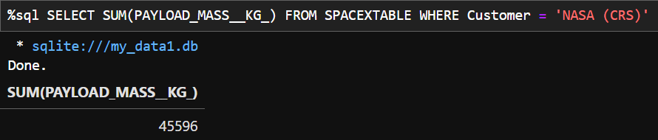
Total Payload Mass Carried by Boosters from NASA
Total payload mass carried by boosters from NASA is 45596 kg.

Slide 33
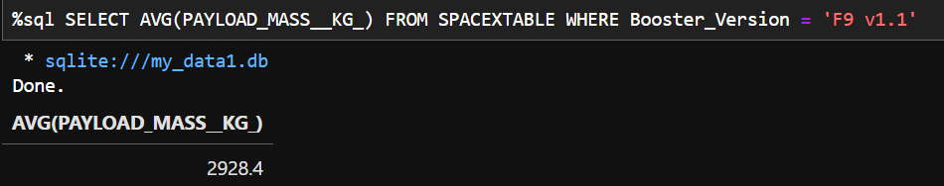
Average Payload Mass by F9 v1.1
Average payload mass carried by booster version F9 v1.1 is 2928.4 kg.

Slide 34
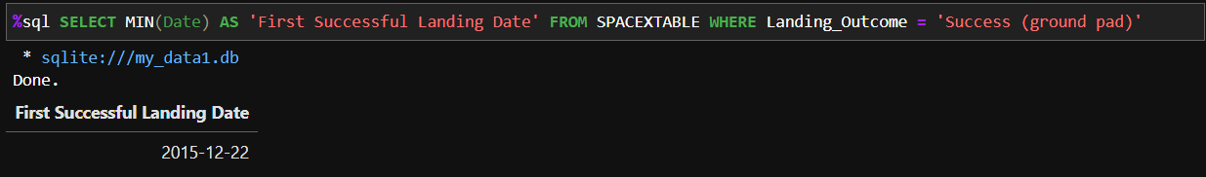
First Successful Ground Landing Date
First successful ground landing date is 2015-12-22.

Slide 35
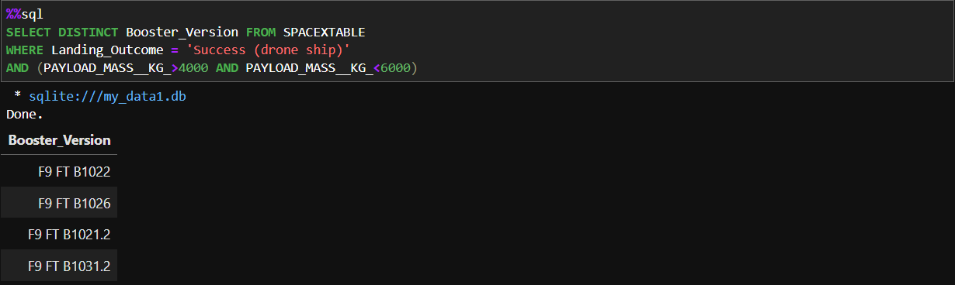
Successful Drone Ship Landing with Payload between 4000 and 6000

Slide 36
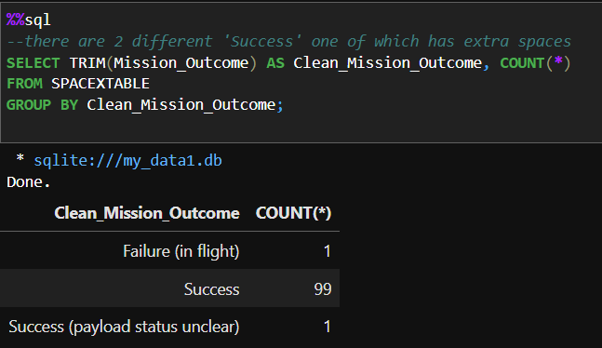
Total Number of Successful and Failure Mission Outcomes

Slide 37
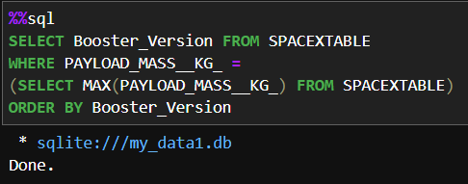
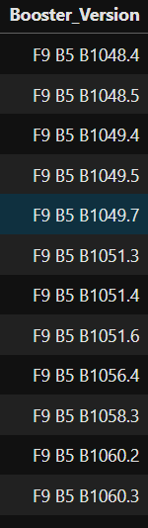
Boosters Carried Maximum Payload

Slide 38
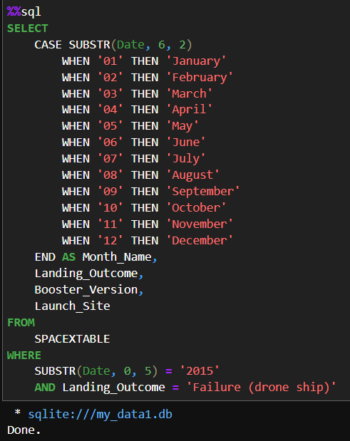
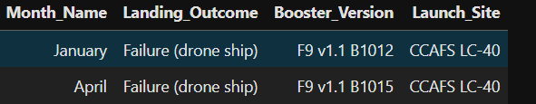
Failed Launches in 2015

Slide 39
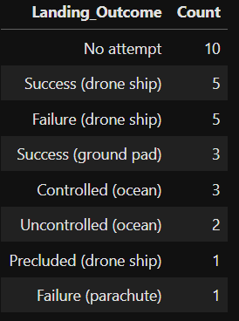
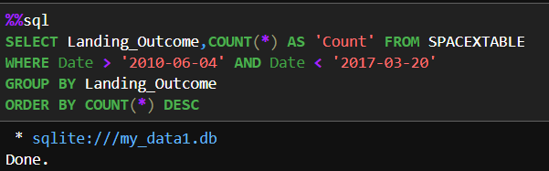
Ranked Landing Outcomes Between 2010-06-04 and 2017-03-20

Slide 40


Slide 41
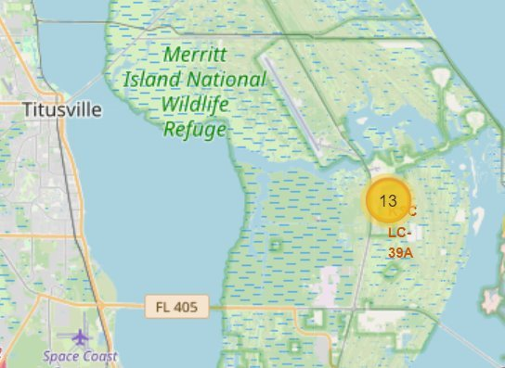
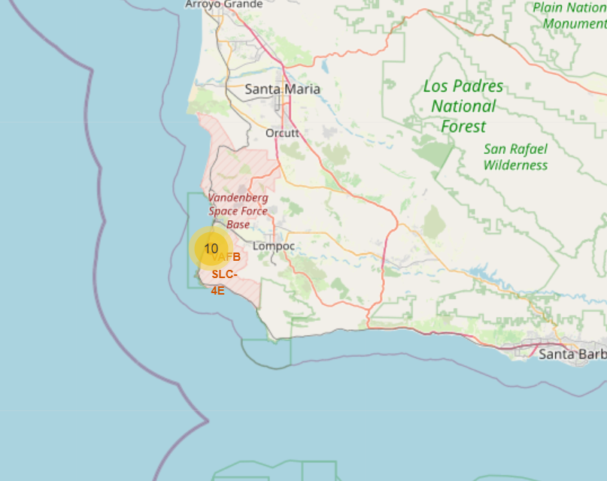
Locations of Launch Sites

Slide 42
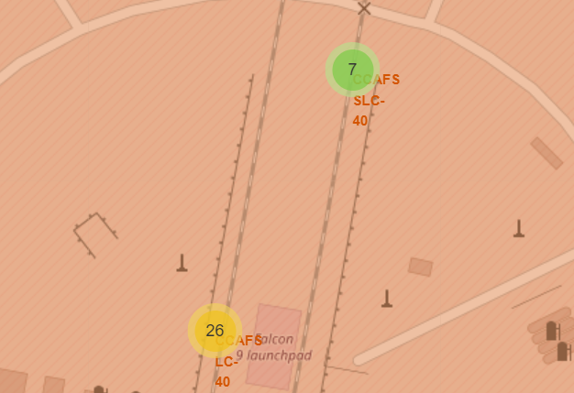
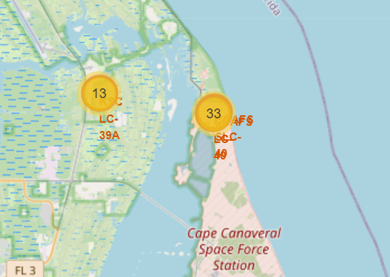
Locations of Launch Sites

Slide 43
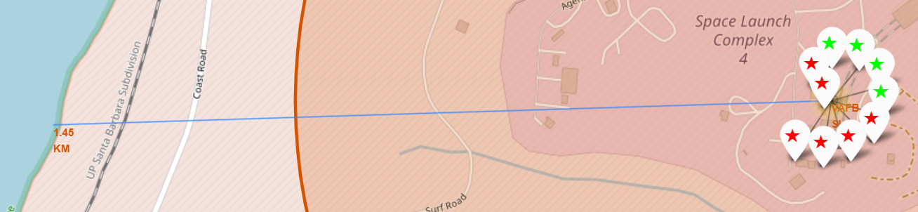
VAFB SCL-4E Launch Outcomes & Coastline Proximity
Green stars denote successes and red stars denote failures.

Slide 44
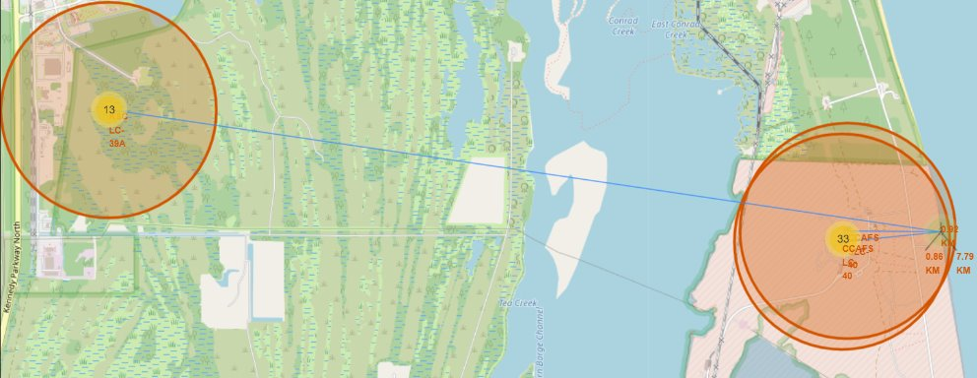
Coastline Proximities of Other Sites

Slide 45
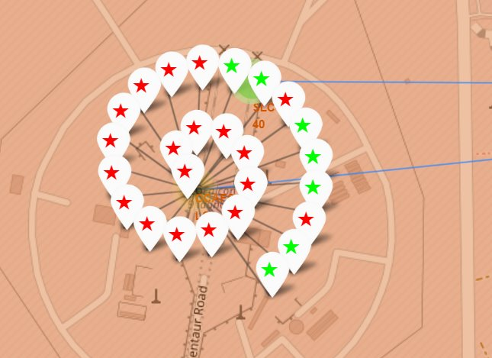
Launch Outcomes for CCAFS-LC-40
Check more at live app

Slide 46


Slide 47
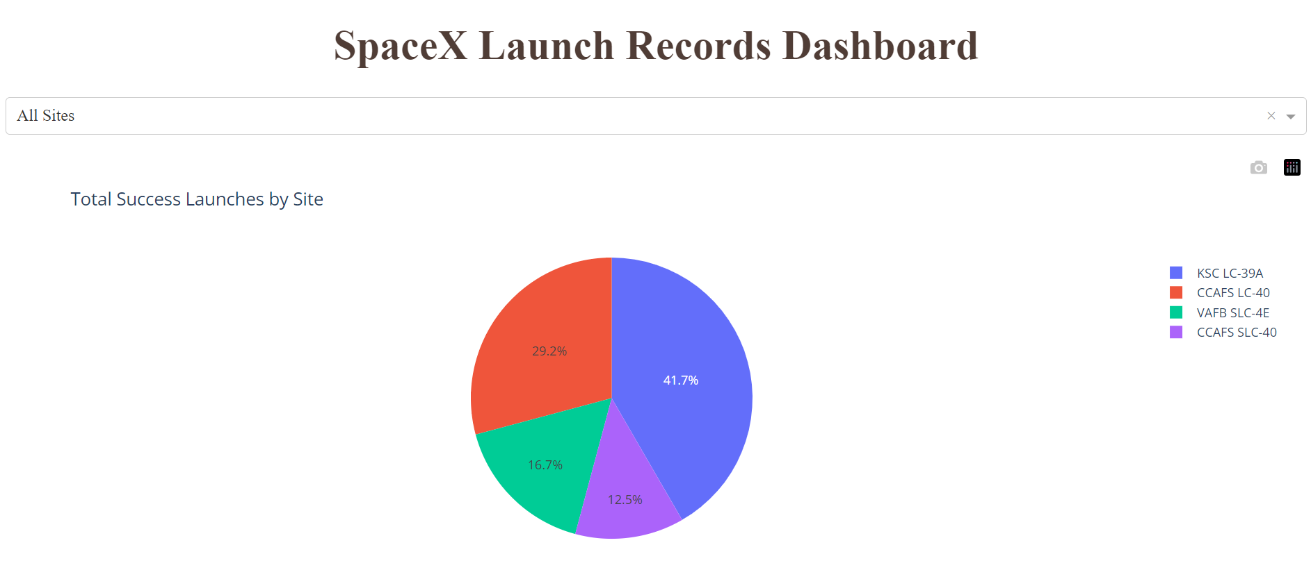
Launch Success Count for All Sites
41.7 % of launches are from KSC LC-39A which is the highest.

Slide 48
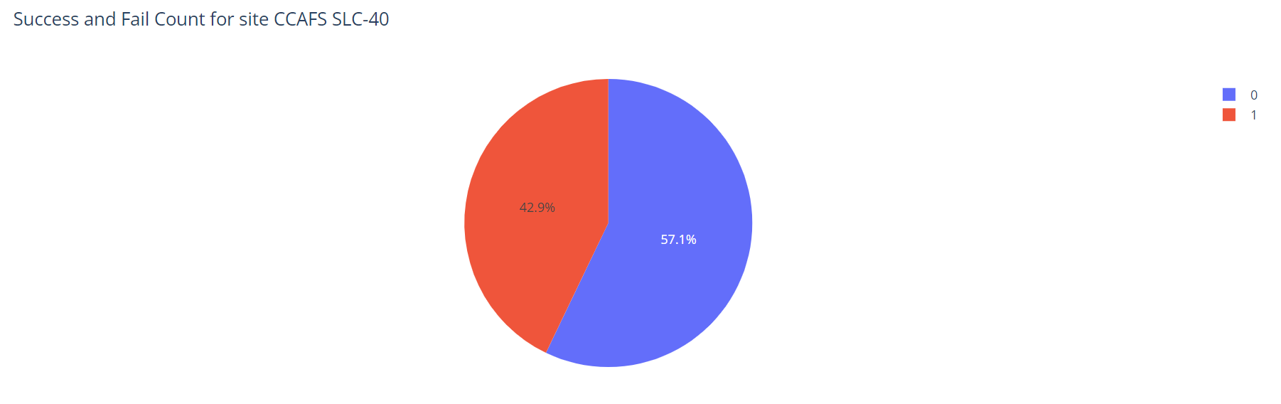
Success vs. Fail Rate for the Site with Highest Success Rate

Slide 49
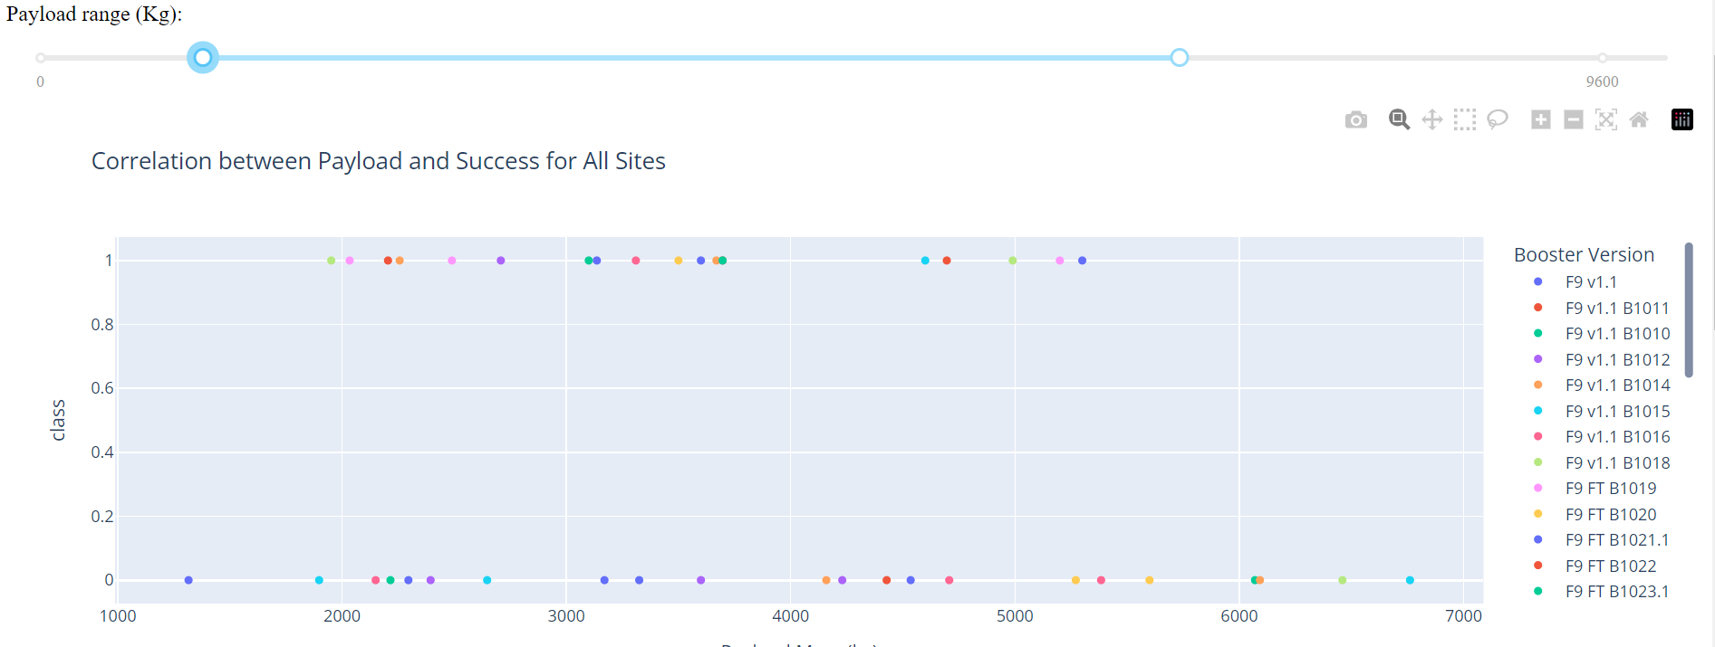
Outcome vs. Payload for All sites for Payload 1000-7000

Slide 50
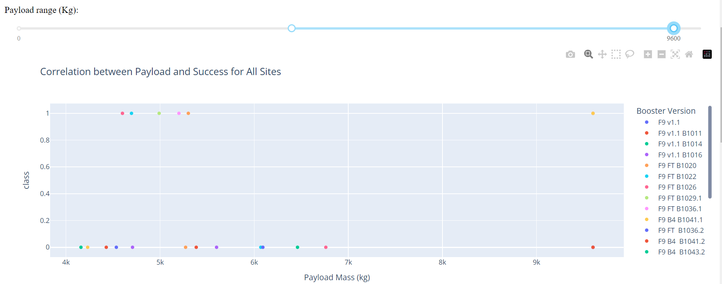
Outcome vs. Payload for All sites for Payload 4000-9600

Slide 51

Section 5

Slide 52
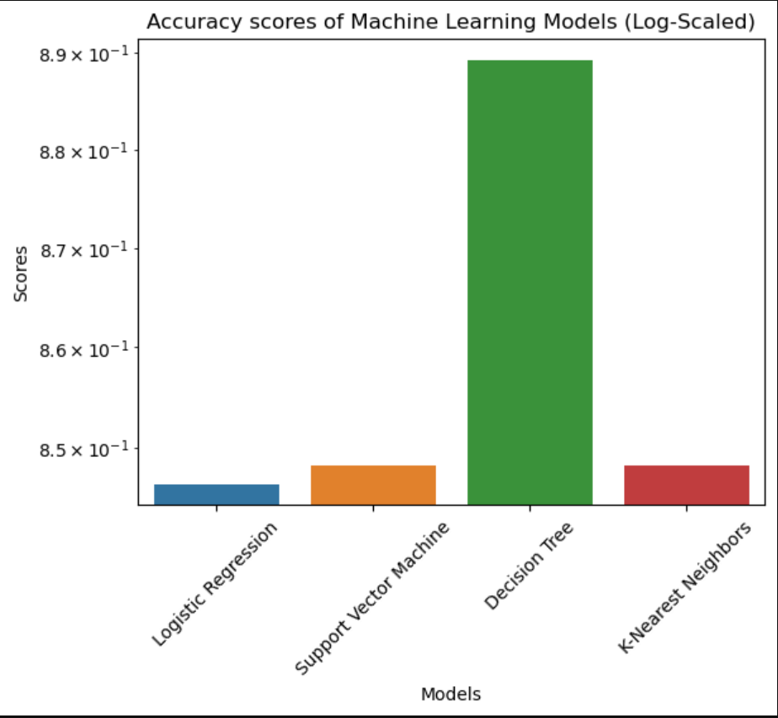
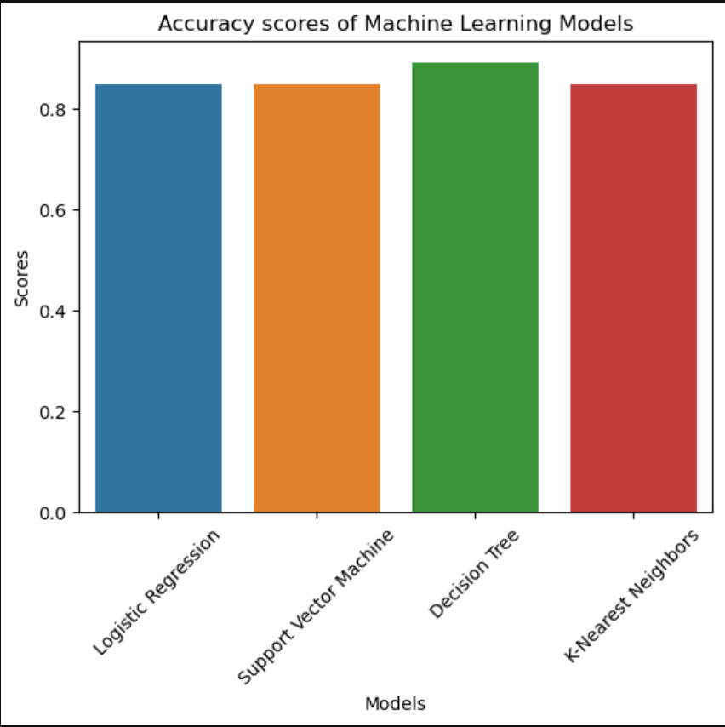
Classification Accuracy

Slide 53
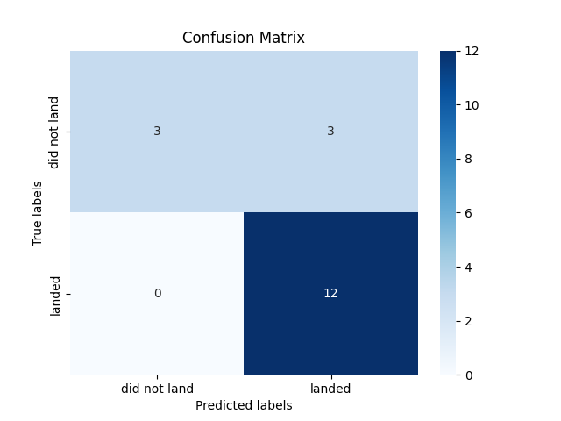
Confusion Matrix of Decision Tree

Slide 54
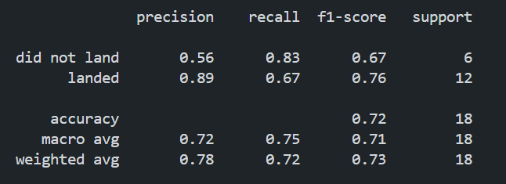
Classification Report of Decision Tree

Slide 55
Conclusions
Overall accuracy is 72%, indicating that it correctly predicts the outcome for 72% of launches.
The performance on negative cases is moderate as the precision is 56%. It identifies 83% of not-landing cases as recall suggests. This is relatively high but causes a trade-off between precision.
The performance on positive cases is relatively high. It predicts the landing returns with 89% precision and 67% recall meaning that it misses 33% of landings. This recall is not satisfying.
Overall: The trade-off between recall and precision should be considered by business owners. Precision on negatives is not a real concern but bad recall on positives could be improved because it may damage monetary decisions.

Slide 56
Appendix
Github Repo
Some similar Studies: 1 2 3
Code to predict the outcome of upcoming Falcon-9 Launch on May 18, 2024

Slide 57
Resources
SpaceX Web Page
SpaceX API
Falcon-9 Wiki
Upcoming Falcon-9 Launches
Some related news: 1 2 3
SpaceX Stats

Slide 58


